Slide 1


Practical
Data Science & Machine Learning:
Overview
BUS152
Spring 2024

Slide 2
Contents
Overview
What is Data Science/Machine Learning?
General Awareness
Analytics Continuum
Types of Machine Learning
Observation Space
What’s a Model?
Model Considerations
In Practice
Lost In Translation
Use Case Ideation
Analytics Process Model
End-To-End
Business Case Examples
SRM Price Pack Architecture (PPA)
Petivity Elimination Predictions
NCI Hopewell Truck Sequencer
Some Advice
Appendix
A1. Growth Prospects
A2. Learning Resources
A3. Learning Roadmap

Slide 3

Artificial Intelligence
Technology systems designed to mimic human intelligence
Field of study which analyzes data to find patterns, extract insights, and enables some beneficial reallocation of resources
Data Science
Computer Science
Mathematics & Statistics
Machine Learning
Data Science
Software Development
Research
Application of code, algorithms, and data, giving
computers the ability to learn and perform a variety of tasks
Domain Knowledge

Slide 4

Analytics Continuum
Significant value can be found anywhere along the spectrum
Implications of increasing complexity
Types and methodologies are non mutually exclusive
Descriptive
Diagnostic
Predictive
Prescriptive
What happened?
Why did it happen?
What will happen?
What should happen?
Summary statistics
Frequency counts / Proportionality
BI Visuals & graphs
Statistical studies
Regression analysis
Hypothesis testing
Probability analysis
Class / Event predictions
Forecasting estimates
Optimization
Dynamic Programming
Reinforcement Learning

Slide 5



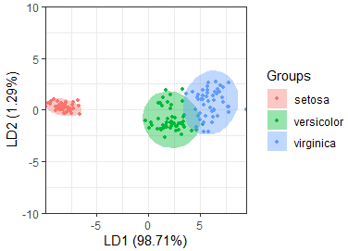

1
Supervised Learning
2
Unsupervised Learning
3
Reinforcement Learning
Machine Learning
Using labeled data to train models to classify, predict, or forecast outcomes
Using unlabeled data to analyze, discover patterns, or find similarity/dissimilarity groupings
Understanding the process of decision making by observing and learning optimal behaviors
Classification (class/event predictions)
Forecasting (numeric predictions)
Regression
Data Mining
Clustering
Dimensionality Reduction
Association Rules
Data Mining
Game/Decision Theory
Operations Research/Optimization
MDPs/Dynamic Programming
Deep Reinforcement Learning
Applications
Predictor Variables
Training Data
Label
No Label
State-Action Policy
Class
Prediction
Model Output
versicolor
New Observation

Slide 6


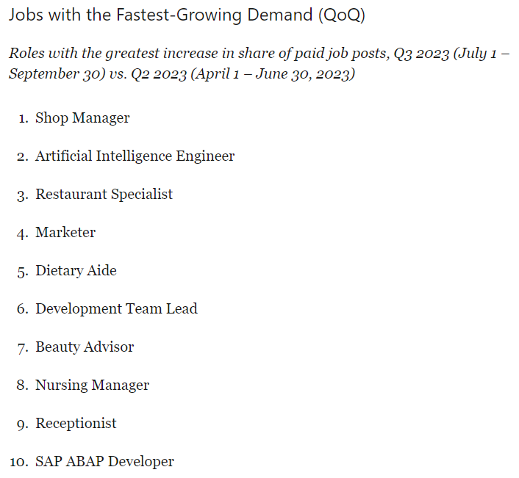
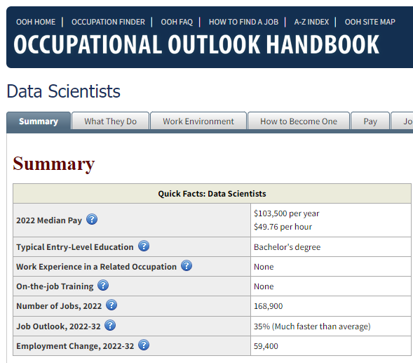

https://www.linkedin.com/business/talent/blog/talent-strategy/most-in-demand-jobs
https://www.bls.gov/ooh/math/data-scientists.htm

